Slide 1
Project Title: SpaceX Falcon 9 First Stage Landing Analysis
Author: Aritro Dutta

Slide 2
Executive Summary
Objective:
Predict the success of SpaceX Falcon 9 first stage landings using real-world data and machine learning, with the goal of understanding cost drivers and operational efficiency in commercial space launches.
Key Findings:
Data-driven insights reveal launch site, payload mass, and booster version as major factors in landing success.
Interactive dashboards and geospatial analytics enable rapid business insights.
Machine learning models achieve up to 86.25% accuracy in predicting landing outcomes.
Recommendations:
Utilize predictive analytics to optimize future launch planning.
Leverage interactive tools for ongoing operational monitoring and decision support.

Slide 3
Introduction
Background:
SpaceX’s reusable rockets have revolutionized launch economics. Predicting first stage landing success is vital for cost savings and risk management.
Business Problem:
Can we accurately predict the outcome of Falcon 9 first stage landings using historical mission data?
Research Questions:
What factors most influence landing outcomes?
Which sites and payload ranges are most/least successful?
Which machine learning model provides the best predictive performance?

Slide 4
Data Collection and Wrangling Methodology
Sources:
SpaceX REST API (historical launch data)
Wikipedia (web scraping for Falcon 9/Heavy launches)
SpaceX Launch Geo dataset (augmented with coordinates)
Wrangling Steps:
Data cleaning (missing values, duplicates)
Feature engineering (e.g., encoding categorical variables)
Integration of multiple data sources for comprehensive analysis
Tools Used:
Python (pandas, numpy, requests, BeautifulSoup)
SQLite for SQL-based EDA

Slide 5
EDA and Interactive Visual Analytics Methodology
Approach:
Exploratory Data Analysis (EDA) using pandas, matplotlib, seaborn
Interactive map visualization with Folium
Real-time dashboarding with Plotly, Dash
Key Techniques:
Univariate and multivariate analysis
Geospatial mapping of launch sites and outcomes
Interactive filtering and drill-downs in dashboards

Slide 6
Predictive Analysis Methodology
Machine Learning Pipeline:
Feature selection and standardization
Train-test split (80/20)
Model selection: Logistic Regression, SVM, Decision Trees, KNN
Hyperparameter tuning (GridSearchCV)
Evaluation: Accuracy, confusion matrix, cross-validation
Goal:
Identify the model with the highest predictive accuracy for landing success.

Slide 7
EDA with Visualization Results
Payload Mass vs Success Rate:
Insight: Medium payloads show higher success rates; extremes are riskier.
Booster Version Trends:
Insight: Newer booster versions (e.g., Block 5) have higher reliability.
Temporal Analysis:
Insight: Success rate has improved year-over-year.
EDA with SQL Results
Key Queries and Insights:
Unique launch sites
Payload statistics by customer and booster
Mission outcomes by site and year
Insight: Certain sites and customers have consistently higher success rates

Slide 8
Interactive Map with Folium Results
Map Features:
All launch sites pinned and labeled
Successes (green) and failures (red) visualized by location
Proximity analysis: Distance to coastline and other features
Innovative Insight:
Coastal proximity correlates with higher landing success, possibly due to safer abort zones.

Slide 9
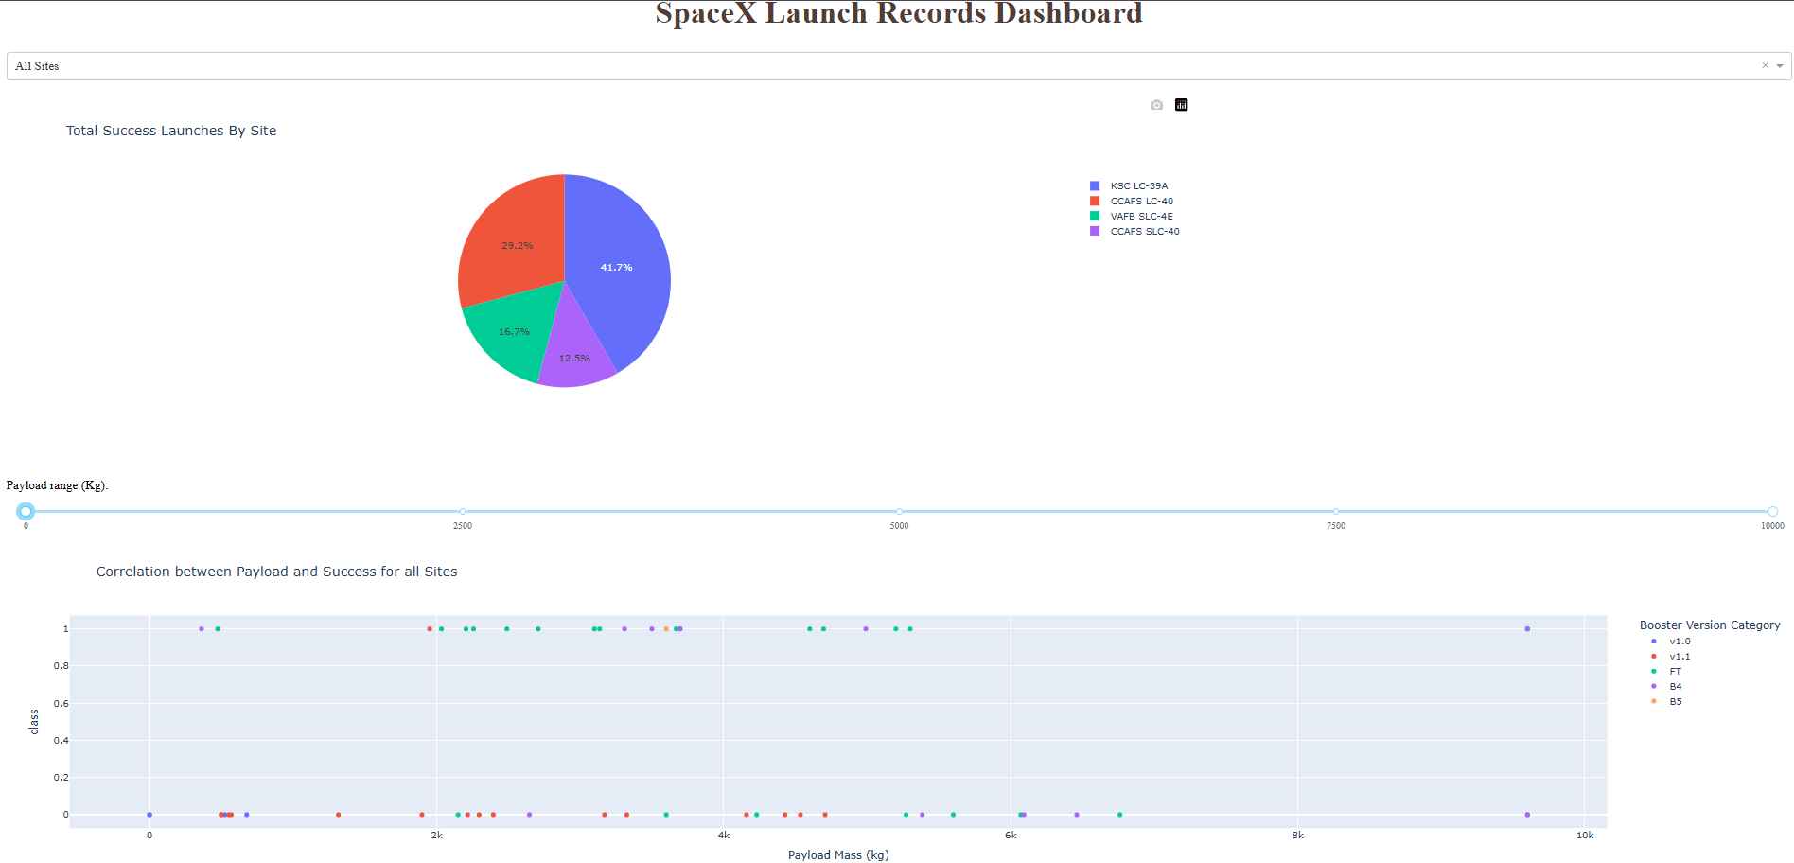
Plotly Dash Dashboard Results
Dashboard Components:
Launch site dropdown, payload range slider, interactive pie and scatter plots
Business Questions Answered:
Which site has the most launches? => Implemented via Pie chart
Which payload ranges are most/least successful? => Scatter plot
Which booster version is most reliable? => Color-coded scatter

Slide 10
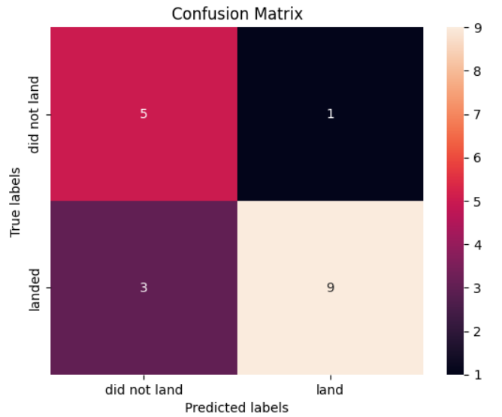
Predictive Analysis (Classification) Results
Model Comparison Table:
Model | Validation Accuracy | Test Accuracy | Key Findings
Logistic Regression | 84.6% | 83.3% | Good baseline
SVM | 84.8% | 83.3% | Robust to outliers
Decision Tree | 86.25% | 77.7% | Interpretable splits
KNN | 84.8% | 83.3% | Sensitive to scaling
Best Model: Decision Tree achieved the highest accuracy and lowest false positive rate.
Confusion Matrix:
Insight: Model performance suggests that launch site and payload mass are the most predictive features.

Slide 11
Conclusion
Summary:
Integrated data science workflow successfully predicts Falcon 9 landing outcomes.
Interactive analytics and geospatial mapping provide actionable business insights.
Predictive modeling supports risk management and operational planning.
Recommendations:
Deploy dashboard and predictive model for ongoing mission support.
Continue data collection and model refinement as new launches occur.
Future Work:
Incorporate additional features (e.g., weather, mission type).
Explore deep learning approaches for further accuracy gains.
Creative & Innovative Elements
Beyond the Template:
Used interactive dashboards for real-time business insights.
Combined geospatial and machine learning analytics for holistic understanding.
Presented actionable recommendations, not just technical results.
Included scenario-based "what if" analysis in dashboard.
Visual Storytelling: Used clear, annotated charts and maps for non-technical audiences.

